Slide 1


Grassroots Preparedness, a Radiation Risk Scale, and
Marketing of Health Physics
Armin Ansari, PhD, CHP
HPS President-Elect
Notes:
Communication is the single most challenging issue in any emergency management situation.
Lesson repeatedly “learned” – again in Japan response.

Slide 2
Preparing for Emergencies particularly in this economy!
Local and state programs doing more with less, or possibly eliminating preparedness activities
Moving forward in an environment of limited resources

Slide 3
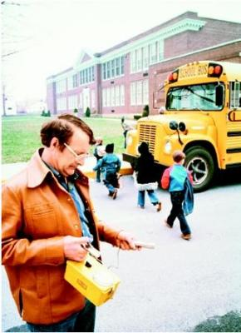
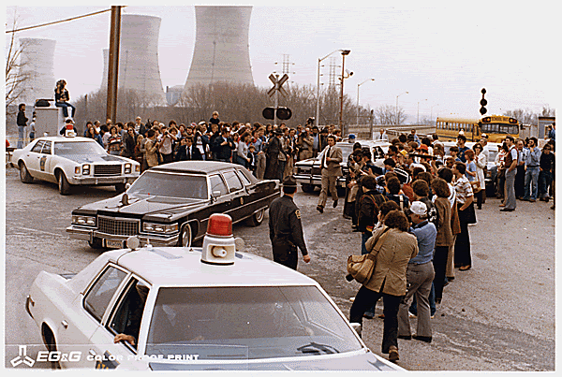
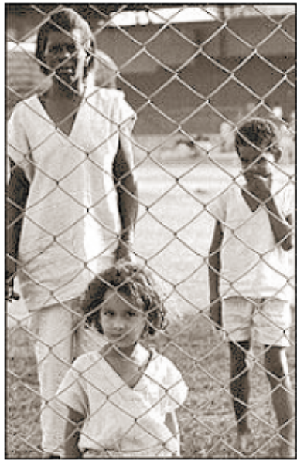
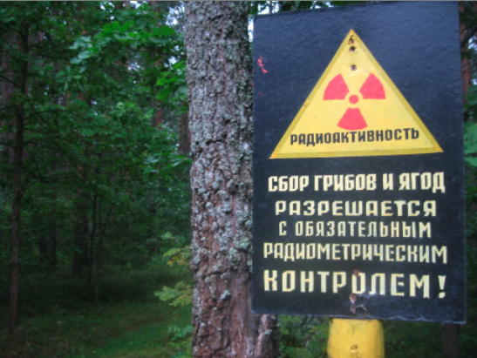
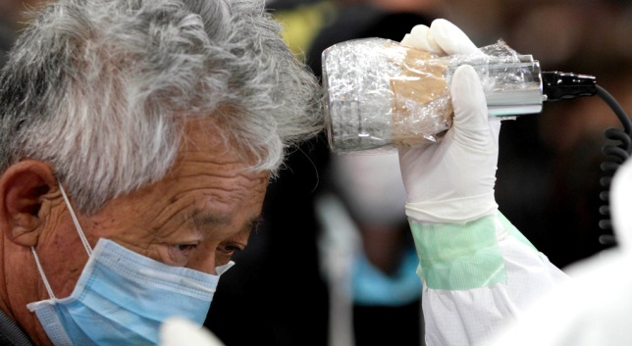
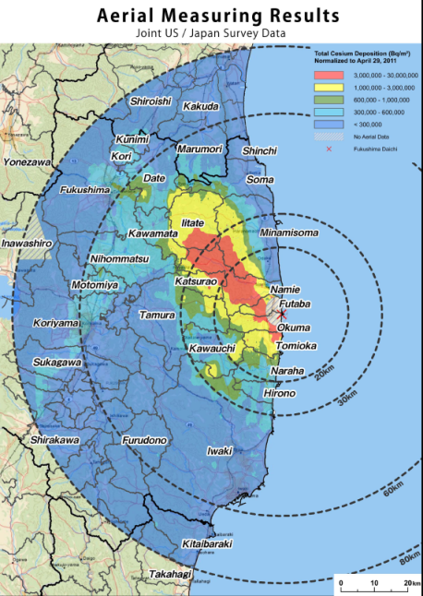
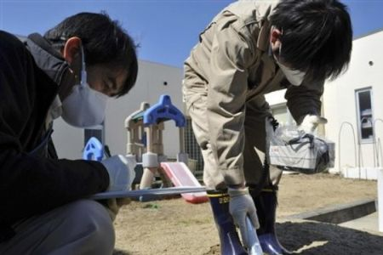
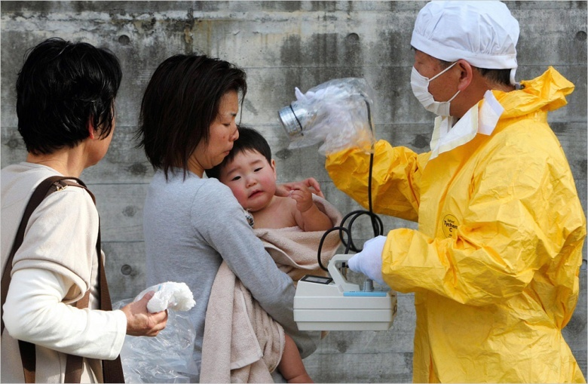
“All Emergencies are Local”

Slide 4
Displaced Population
Chernobyl (1986)
  116,000 initially from the 30-km radius
  210,000 additional from Ukraine, Belarus, and Russia
Fukushima (2011)
  170,000 from the 20-km radius
  450,000 people occupy 2600 evacuation centers
Our National Planning Scenarios
  IND (scenario 1) – One million + self evacuate
  RDD (scenario 11) – Hundreds of thousands self evacuate

Slide 5
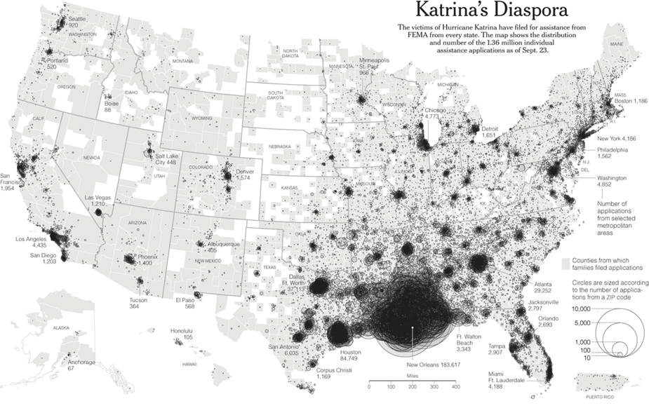
Hurricane Katrina (2005)
Example of a Displaced Population
Notes:
Note that half (46%) are within 100 mile radius in this case – will be different in nuc/rad
Depending on how far from incident
Community most definitely impacted

Slide 6
Need for Radiation Professionals in a large scale radiation emergency
Monitoring environment and workplace
Monitoring people
Supporting operations at:
  Hospitals
  Public and special needs shelters
  Emergency operation centers
  Community reception centers
Communications
A Local Effort?!

Slide 7
Where Does Radiation Expertise Come From?
State
Federal
Mutual Aid
Local community

Slide 8
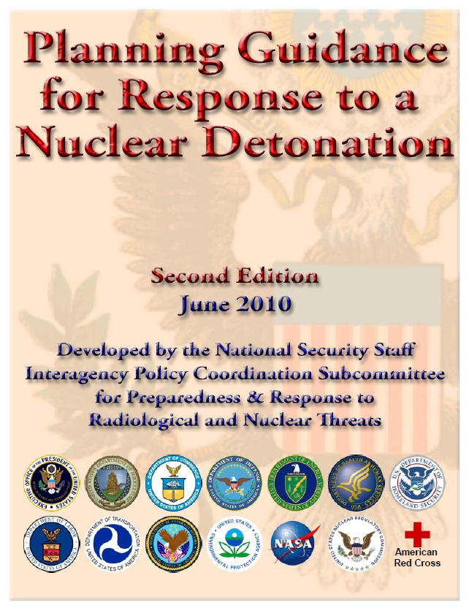
Call for Radiation Response Volunteers
“Planners should identify radiation protection professionals in their community and encourage them to volunteer and register in any one of the Citizen Corps or similar programs in their community.”

Slide 9







Radiation Professionals
Potential pool of tens of thousands who can volunteer in their local communities.
After a radiation emergency, many are likely to volunteer.
  Spontaneous Unaffiliated Volunteers (SUVs)
We need trained affiliated volunteers
Notes:
American Society of Radiologic Technologists; American Registry of Radiologic Technologists (300,000).

Slide 10
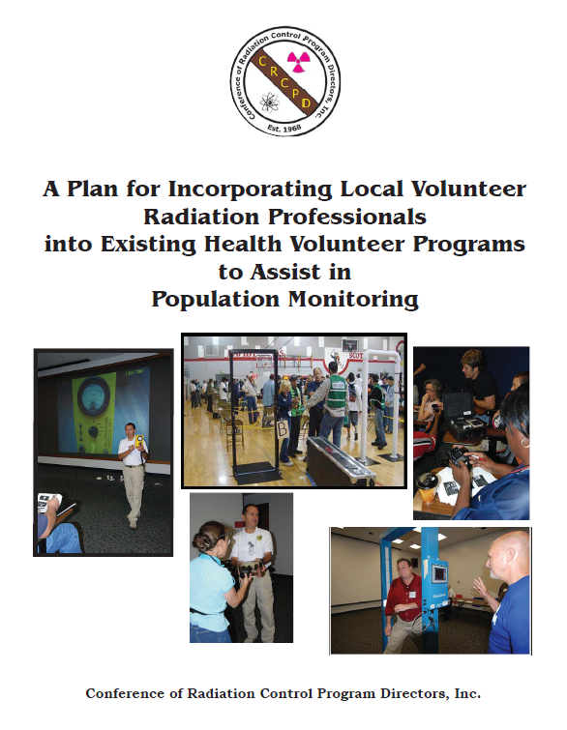
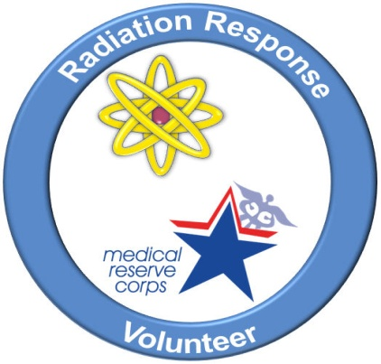
Radiation Response Volunteer Corps
CDC, CRCPD, MRC partnership
Recruiting local radiation professionals
March 2011
www.crcpd.org/Homeland_Security/RRVC_FinalReport.pdf
Notes:
Mention HPS Homeland Security Committee (New Section!)
Opportuntiy for involvement
Rewarding
Empowerment
Community Resiliency
Requires little

Slide 11
Funding opportunities through CRCPD for local/state agencies and non-profit professional organizations, such as HPS, AAPM, ANS, SNM chapters.

Slide 12

Risk Communication
Notes:
HPS meetings, PDS, PEP

Slide 13
Risk Communication Issues
Are we meeting audience needs for information?
  Coworkers
  Managers/decision makers
  General public
How can we bridge the gap between technical information and risk perception?
Can we provide information in ways that promote responsible public action?
Notes:
Audience research, good risk communication and related talks at HPS meetings
Issues Not unique to radiation
Example = Toyota January 2010
Sudden acceleration and sticky pedal
Japan response – technical info – what is “safe”

Slide 14
What is a “Safe” Dose of Radiation?
I asked a group of
radiation safety professionals
Notes:
straight from the horse’s mouth

Slide 15
I asked …
What do you consider a safe radiation dose for you?
For your children? (or grandchildren, favorite nephew, etc.)
For your in-laws? … just kidding.
Notes:
Grandchildren nephew

Slide 16
Clarifications
Question is about an acute one-time dose.
Assume no particular benefit (medical, life-saving, returning home, etc.)
Apply definition of safe as you see it.
  No need to provide reasoning, explanation, or justification.
  Just a number you feel comfortable with.
  If not comfortable with a numeric answer, please say why.
Not looking for a scientific answer. Looking for personal perception.
Any radiation dose is in addition to the natural background dose wherever you live.
All answers are treated confidentially.

Slide 17
47 Respondents
All radiation professionals
41 HPS members (87%)
21 CHP (45%)
16 PhD (34%)
10 PhD/CHP
3 MD

Slide 18
Respondents
Health physicists, medical physicists, radiation biologists, radiation safety officers, public health professionals, and clinicians.
Employment: Federal, state, and county governments (including state radiation control and county health department), military, university and university hospitals, private sector (nuclear energy and instrumentation), and consulting.

Slide 19
Their Commentary on
Safe Dose Value
"throw away dose"
“wouldn't have second thoughts”
“wouldn't be concerned with”
"accidental or unaware dose"
“would not worry about it”
"take it without much thought
“without thinking too much"
"no probable long-term effect"
"minimal risk"
“if it can't be avoided”
“would not be concerned” with it”

Slide 20
“Safe” Dose
Range: 1 mSV to 1000 mSV (adults)
0.3 mSV to 250 mSV (children)

Slide 21
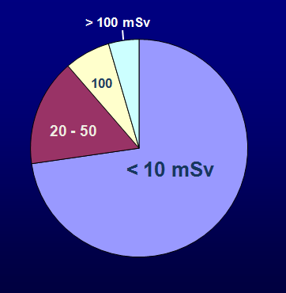
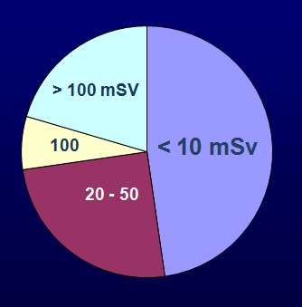
“Safe” Dose
Adults
Children
Adults
  10 mSv (26%)
  50 mSv (23%)
Children
  1 mSv (21%)
  5 mSv (21%)
Notes:
Family feud! The no.1 answer.

Slide 22
No Numeric Answer
6 Respondents (13%)
  5 HPS members, 2 MD, 1 CHP
Comments:
  “I don't use the term safe … You can make things safer and therefore acceptable to most people, but depends on the context.“
  “There isn't a ‘safe’ dose”.
  “No such thing as a safe but unnecessary dose.”
  “Safe is too subjective. I would avoid saying a dose is safe or it isn't safe

Slide 23
The In-Laws!
The mother-in-law dose should be “far higher” than the father-in-law dose.
Doses ranged up to 2000 Gy!
One respondent assigned a dose of 10⁹ Gy to in-laws who had already passed away.

Slide 24
What is perceived as a safe dose of radiation varies widely even among a group of radiation professionals.
Notes:
Below Regulatory Concern
De minimis dose at 1% of regulatory limits for members of the public.

Slide 25
Challenge of Communication
“Safe”
“Below Regulatory Concern”
“De minimis”
“Negligible Individual Dose”
“Not a public health concern”
Hazardous
Safe
Notes:
Relative attributes
Judged differently in different contexts

Slide 26
Radiation Risk Scale

Slide 27
Radiation Risk Scale
5) Life hazard (hours to days)
4) Risk of radiation sickness in near term (days to weeks)
3) Risk of cancer in the long term (years)
2) Above natural background, but no measurable health risk
1) Normal, within the range of natural background radiation
Notes:
Example polonium poisoning
Assigned to produce, assigned to farming, swimming
Consuming water for a few weeks or few months at levels exceeding EPA drinking water guidelines

Slide 28
Radiation Risk Scale
Advantages
Simple
Conveys meaning, provides frame of reference
No need for radiation measurements or units
Not affected by differences in standards or regulatory limits
Can be used to promote responsible action during an emergency situation or in its aftermath
Notes:
how would this be applied? How would the levels be determined and by whom?
Example polonium poisoning
Assigned to produce, assigned to farming, swimming
Consuming water for a few weeks or few months at levels exceeding EPA drinking water guidelines

Slide 29
Applied to a Variety of
Circumstances
2 Gy
0.5 Gy
50 mSv
Location Specific

Slide 30
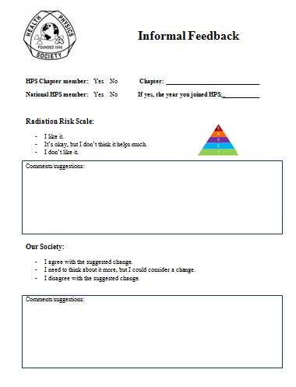
Your Feedback Please

Slide 31

Radiological Quantities: SI and Obsolete Units
Bq Ci rem rad Gy Sv
mrem/h Bq/kg rem/y R
R/h mSv
mCi μSv pCi/g pCi/m³
mSv/y mrem mSv/h
μR/h Bq/L
nGy/h kBq/cm² pCi/L
μCi/cm² MBq Bq/m²

Slide 32

HPS Position
Adopted by the Board on June 26, 2011
  “SI units should be used exclusively
  when expressing radiological quantities.”

Slide 33
Society Membership

Slide 34
Society Membership

Slide 35
Society Membership
Age Survey
Source: 2011 HPS Board packet addendum, p.55, n=2465.

Slide 36
Society Membership

Slide 37
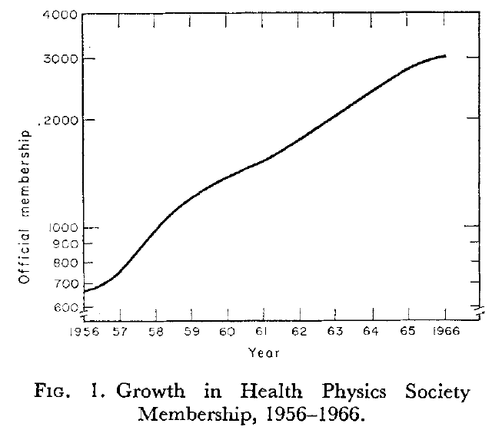
The Origins of the Health Physics Society
Ronald L. Kathren and Natalie E. Tarr, 1974, Health Phys. 27,419
Members flocked to HPS
Overwhelming international response led to formation of sections, organized along national lines
  France (1961), Japan (1962), UK (1963)
HPS helped create IRPA, its constitution adopted 12/2/1964
Notes:
These sections serving as national health physics organizations. Their presidents serving as ex officio members of the HPS Board of Directors.
Mention suggestions re annual meeting, section involvement, etc. But concentrate on one suggestion here and receive feedback.

Slide 38
HPS
We are the only professional society in the country whose main mission is to advance and promote excellence in the science and practice of radiation protection!
Networking and professional enrichment opportunities.
  at modest cost
Growing number of professionals from various disciplines working in medicine, industry, government, or academia who are or should be interested in radiation protection issues.
Notes:
Expand on professional enrichment – outside current job environment
At a modest price – take your family out to movies and eat out one day.

Slide 39
Better Marketing?
Still struggling to identify ourselves!
Our name is part of our identity.
An organization’s name can project authority.
  e.g., American Medical Association, American Dental Association, American Academy of Pediatrics.
Is it finally time to consider a name change?

Slide 40
A Suggestion
Our use of the terms health physics and health physicist remains the same.
American Academy of Health Physics remains the same.
American Board of Health Physics remains the same.
The certification process and the term Certified Health Physicist remains the same.
The name of our journal, Health Physics, remains the same.

Slide 41
A Suggestion (cont.)
The only change to consider is the name of our Society to better reflect who we are and what we do.
  Examples:
    American Radiation Protection Association
    American Association of Radiation Safety Professionals
    American Society for Radiation Safety
    American Radiation Safety Association

Slide 42
Advantages
It can better describe and project who we are.
It can enhance the perceived stature, standing, and importance of our Society among decision makers, the media, and the public.
It may help attract professional members, academicians, clinicians, and others who have an interest in radiation safety, but don’t consider themselves “health physicists.”
Notes:
When there was noise about the radiation scanners at airports, wouldn’t it have been nice to know what the “American Radiation Protection Association” have to say about the issue? We were not noticed at all in most stories on the subject and we are the premier organization to comment on it.

Slide 43
Main Arguments Against
A name change makes us lose our identity and the recognition/reputation we have established in Congress and with the media.
Our “clout” may actually be enhanced with a name change.
HPS is not a name that grabs many headlines.
HPS fact sheets and position statements may excite us who are HPS members and a handful of others, maybe even some congressional staffers, but the impact is not wide.
A position statement of something like “the American Radiation Protection Association” will project more authority and inherently carries more weight.
Notes:
For example, when the American Academy of Pediatrics issues a statement about something child related, I listen. I don’t know them at all or who their president or board members are, but the name of their organization is enough for me to listen.
Radiological Society of North America (RSNA) – 110 million dollars in assets – 46,210 members from 125 countries – publishing Radiology - Once started in 1915 as Western Roentgen Society.

Slide 44
a bit of history …
The term health physics has its origin in the Manhattan District Operations – 1943 Chicago.
The coinage merely denoted the physics section of the Health Division.
It also served security: "radiation protection" might arouse unwelcome interest; "health physics" conveyed nothing.“
http://www.orau.org/ptp/articlesstories/names.htm#healthphysics

Slide 45
“HPS” was not a unanimous name choice
A 1955 committee chaired by Lauriston Taylor considered 11 different names for the new society.
Offered membership a choice of 2 names to vote on:
  “Society for Radiation Protection”
  “Health Physics Society”
Shortly before the meeting adjourned at 10:30 PM (June 25, 1956), a majority of 198 members present voted for HPS.
Not including “U.S.” or “American” in the name was intentional to attract international members.
Source: Ronald L. Kathren and Natalie E. Tarr, 1974, Health Phys. 27,419

Slide 46

International Radiation Protection Association (IRPA)
Sociedad Argentina de Radioproteccion
Australasian Radiation Protection Society
Austrian Association for Radiation Protection
Belgian Association for Radiological Protection
Sociedade Brasileira de Proteção Radiológica
Bulgarian Association of Radiobiology and Radiation Protection
Canadian Radiation Protection Association
Chinese Society of Radiation Protection
Asociación Colombiana de Protección Radiológica
Croatian Radiation Protection Association
Cuban Physics Society, Radiation Protection Section
Cyprus Association of Medical Physics and Biomedical Engineering
Czech Society for Radiation Protection
Eastern Africa Association for Radiation Protection
IRPA Egypt Radiation Protection Group
Société Française de Radioprotection
German-Swiss Association for Radiation Protection
Greek Radiation Protection Association
Health Physics Section of the Roland Eötvös Physical Society, Hungary
Indian Association for Radiation Protection
Iranian Radiation Protection Society
Irish Radiation Protection Society
Israel Society for Radiation Protection
Associazione Italiana di Radioprotezione
Japan Health Physics Society
Korean Association for Radiation Protection
Lithuanian Radiation Protection Center
Association Nationale de Radioprotection-Madagascar
Malaysian Radiation Protection Association
Sociedad Mexicana de Seguridad Radiológica
Moroccan Association for Radiation Protection
Dutch Society for Radiation Protection
Nordic Society for Radiation Protection
Sociedad Peruana de Radioproteccion
Philippine Association for Radiation Protection
Radiation Protection Section, Polish Society of Medical Physics
Sociedade Portuguesa de Protecçao Contra Radiaçoes
Romanian Society for Radiological Protection
Russian office of Radiation Hygiene
Radiation Protection Society of Serbia and Montenegro
Slovak Society of Nuclear Medicine and Radiation Hygiene
Radiation Protection Association of Slovenia
South African Radiation Protection Society
Sociedad Española de Proteccion Radiologica
Society for Radiological Protection - United Kingdom
Uruguayan Society of Radioprotection
Health Physics Society (USA)
Notes:
47 organizations – a great majority have the phrase “radiation protection” in their names.

Slide 47
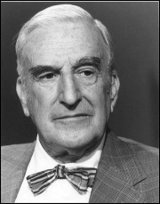
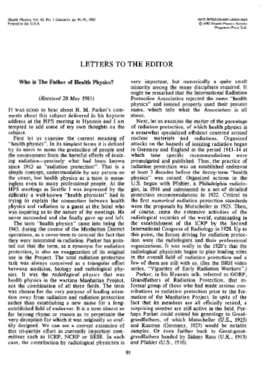
Questioning the Name
Health Physics 42: 91-92, 1982
“chosen for the very purpose of leading attention away from radiation and radiation protection rather than establishing a new name for a long-established field of endeavor.”
“misnomer”
“cover-term to conceal”
“exaggeration of its original use in the Project.”
“decoy-term”
Notes:
His argument was that the term excludes medicine and biology and stresses only a part of the larger radiation protection field with a misleading name at that! Suggested “American Radiation protection Society

Slide 48
Your Feedback Please
Notes:
Volunteer for committee

Slide 49
Vision For 2020
“Recognized by its members, stakeholders and the public as the international voice of the radiation protection profession in the enhancement of radiation protection culture and practice worldwide.”
Notes:
For HPS in the United States?

Slide 50
Thank you!
Armin Ansari
770-488-3654
AAnsari@hps.org

Slide 51
News from HPS
Notes:
If interested to volunteer for HPS Committee – indicate on back of the survey form,
HSC changing to a Section (more opportunity to be involved.
another dues increase, the HP News is going electronic,

Slide 52
Chapter Special Activities Grant Program
Administered by the Society Support Committee
Priority given to:
  Chapters with few financial resources
  Innovative activities that could be model for other chapters
Simple application process
Contact Society Support Committee
Notes:
$1000 budget, but if used, may consider increasing because of importance of chapters – recognized.

